Slide 1

Hospital Database Management System
This presentation outlines the development of a comprehensive hospital database management system. The project aims to streamline administrative processes, improve patient care, and enhance overall operational efficiency.
Manas Dubey
Happy Singh
Aman Kaushal
MD
Notes:
• This new hospital database system will revolutionize how we manage patient records and administrative tasks. • It has been designed to streamline processes, improve patient care, and boost overall operational efficiency. • The system will centralize all hospital data, making it easier to access, analyze, and act on critical information. • Key features include automated appointment scheduling, electronic medical records, inventory management, and robust reporting capabilities. • By implementing this system, we aim to enhance the patient experience, optimize resource allocation, and drive continuous improvement across the organization. • I'm excited to walk you through the specific capabilities and benefits of this transformative technology.
1

Slide 2
Introduction to the project
The Hospital Database Management System (HDMS) is designed to centralize and manage all critical information related to hospital operations, including patient records, medical history, appointments, medications, and billing details.
The system aims to create a unified platform that streamlines administrative tasks, improves communication among healthcare providers, and ultimately elevates the quality of patient care.
Notes:
2

Slide 3
Key Features
Physicians
Patients
Departments
Comprehensive physician profiles, credentials, specializations, availability schedules, and patient interactions.
Detailed patient records, medical history, allergies, medications, appointments, and insurance information.
Management of departments, staff, resources, schedules, and patient flow within the hospital.
Medications
Appointments
Inventory management, dispensing records, prescription tracking, and medication alerts for patient safety.
Scheduling, reminders, confirmations, patient check-in, and integration with electronic health records (EHR).
Notes:
3

Slide 4


Why We Need This System
1
Streamlined Administration
2
Better Patient Care
Provide access to comprehensive and updated patient information, facilitating informed decision-making by healthcare providers.
Simplify administrative processes, reducing paperwork and manual tasks, enabling more efficient staff allocation.
3
Compliance
4
Efficiency
Ensure compliance with regulatory requirements, data security standards, and HIPAA guidelines, protecting patient confidentiality.
Improve overall operational efficiency, reducing waiting times, minimizing errors, and optimizing resource utilization.
Notes:
4

Slide 5




Summary of the Project
Data Centralization
Security and Privacy
The HDMS will create a central repository for all hospital-related data.
Robust security measures will be implemented to protect sensitive patient information.
Data Analytics
The system will provide insightful data analytics to improve decision-making.
Notes:
5

Slide 6




Modern and Visually Appealing Design
1
User-Centric Design
2
Intuitive Navigation
Easy-to-use interface.
3
Mobile Responsiveness
Access from various devices.
4
Visual Clarity
Organized data presentation.
Notes:
6

Slide 7
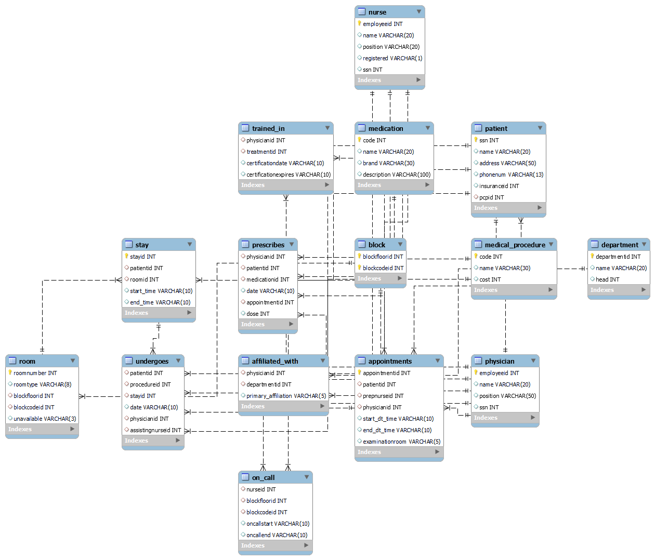

Slide 8

Implementation Plan and Timeline
Development and Testing
Requirements Gathering
Build the system, conduct thorough testing, and ensure quality assurance.
Collect user needs and system requirements.
1
2
3
4
System Design
Deployment and Training
Develop detailed system architecture and design specifications.
Deploy the system, provide user training, and ensure smooth integration.
Notes:
7

Slide 9
Conclusion and Next Steps
1
Streamlined Operations
The HDMS will optimize administrative processes.
2
Enhanced Patient Care
The system will empower healthcare providers.
3
Improved Efficiency
The HDMS will contribute to better resource utilization.
Notes:
8

